Slide 1
PROCESSOR FUNCTION AND STRUCTURE:
PRESENTATION BY: SEJAL SEETLANI , ALI KHAN MAGSI , VISHAKA PAHUJA
ASSIGNED BY: SIR ABDUL HASEEB SHAIKH

Slide 2
Objectives:
PROCESSOR ORGANIZATION
CPU FUNCTION
CPU WITH SYSTEM BUS
CPU INTERNAL STRUCTURE

Slide 3
CPU FUNCTION
Fetch Instruction
Interpret Instruction
Fetch Data
Process Data
Write Data

Slide 4
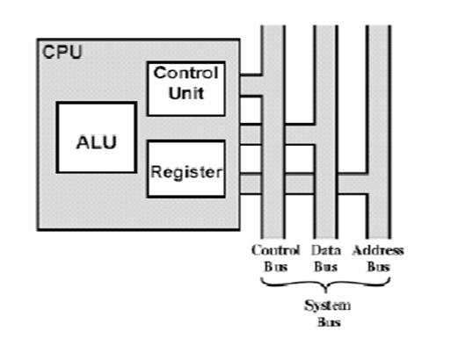
CPU WITH SYSTEM BUS

Slide 5
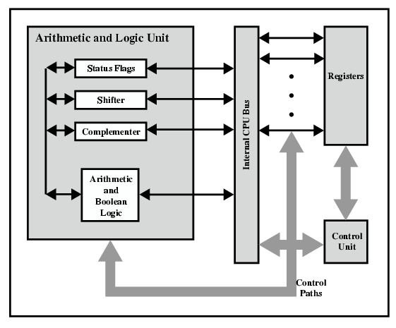
Internal structure of the CPU:

Slide 6
Register Organization
By Ali Khan

Slide 7
Table of contents
01
04
02
05
03
06
1
Reg organization.
Data Register
User-visible Reg
Address register
General purpose
Condition code Flags

Slide 8
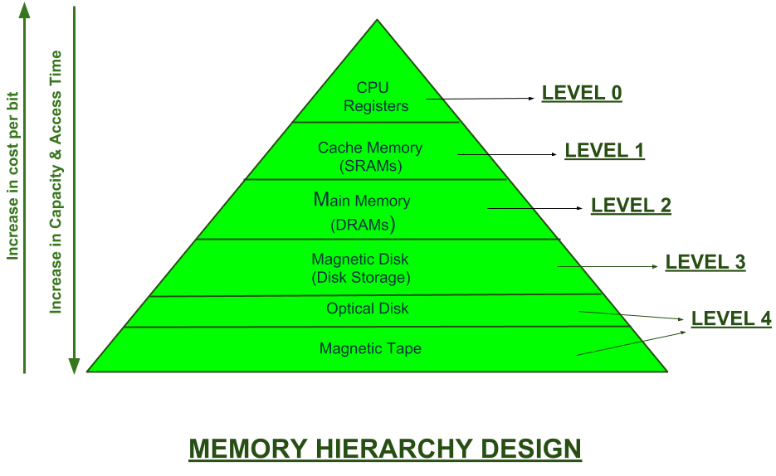
2

Slide 9
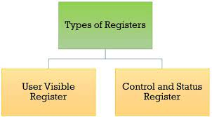
3

Slide 10
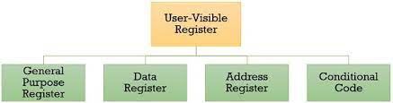
4

Slide 11

User-visible Registers
5
Enable Assembly programmers to minimize the use of Main memory.
By using registers.
Perform various operations .
Directly manipulated by users.

Slide 12
General Purpose Registers
6
General Purpose Registers Can hold any type of data
Used for temporary storage & calculations
General Purpose Registers used for wide range
Holds variables during program execution

Slide 13
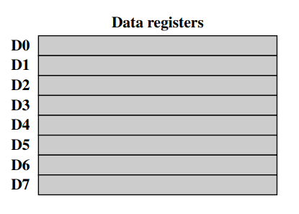
Data Register
7
holds the data Value:
such as integer, floats and charachters
Arthmatic/logic oper
Add, sub, Div, Mul, AND, XOR, NOR
Moving data
Transferring, Swapping, Loading

Slide 14
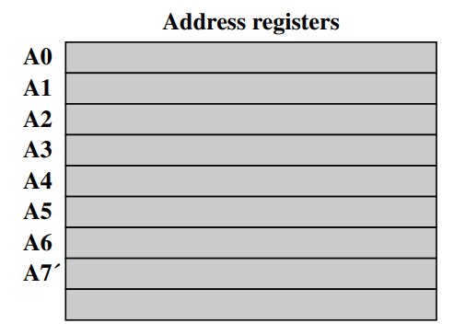
Address Register
8
Type:
itself type of General purpose Register
Holds
holds the memory addresses.
Memory is vast with millions of cells
Guide
when processor wants to modify the data, AX provides the address of that data.

Slide 15
Address Registers Cont.
9
Stack Pointer
Index register
Segment Reg.
Stack pointer is Special type of register.
Keep the track of top of stack in memory.
Used for temporary storage in LIFO order.
It is also called offset register.
Used for index addressing.
Used in mostly Arrays and data Structure
It makes the portions in memory.
Divides the memory. into logical segments.
Each portion has separate area.
CS, DS, SS, ES

Slide 16
Condition Code Flag (CCF)
10
Definition
Step-1
Step-2
Keep a record of operations and CMP
Refers to Status FLag
helps program in decision making based on previous result.
A = 8
B = 3
If (A > B) {
A is greater
}
else {
A < B }
After comparison CCF are updated based on subtraction.
Lets say A > B
Step-3
Step 5
9
Step-4
CCF include one pos+ flag & one Zero flag.
PF will indicate A>B
ZF will be clear because result is positive
Base on result program will make decision
Program will use conditional branch
If A>B positive flag is set
If A=b zero flag is set
Else A<B

Slide 17
Thanks
Do you have any questions?
End

Slide 18
Control and status register:
Program counter (PC)
Contains the address of an instruction to be fetched
Instruction register (IR)
contains the instruction most recently fetched
Memory address register(MAR)
contain the address of the location in the memory
Memory buffer register(MBR)
contains a word of data to be written to memory or the word most recently read

Slide 19
Program status word:
A set of bit which includes condition codes
Sign:
contains the sign bit of the result of the last arithmetic operation
Zero:
set when result is zero
Carry:
set if an operation resulted in a carry
Equal:
set if a logical compare result is equality
Overflow:
used to indicate arithmetic overflow
Interrupts enable/ disable:
used to enable or disable interrupts
Supervisor:
Indicates whether the processor is executing in supervisor or user mood

Slide 20
Supervisor mode:
Intel ring zero
Kernel mode
Allows privileged instruction to execute
Used by operating system
Not available to user programs

Slide 21
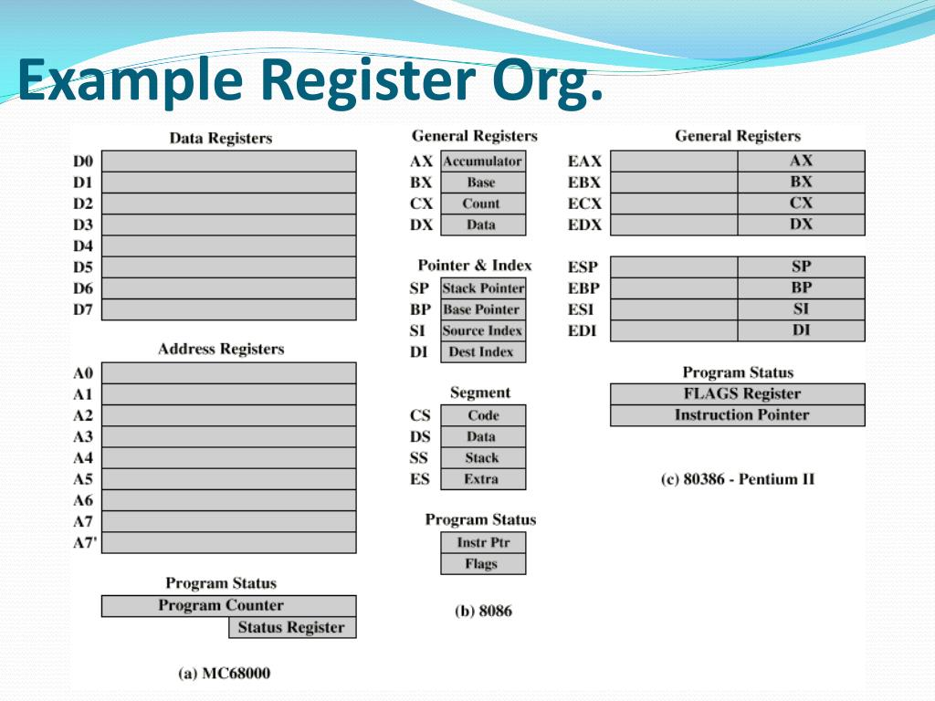

Slide 22
INSTRUCTION CYCLE:
An instruction cycle (sometimes called fetch-and-execute cycle, fetch-decode-execute cycle, or FDX) is the basic operation cycle of a computer.
The processing involved in the execution of a single instruction is termed as Instruction Cycle.
A program residing in the memory unit of a computer consists of a sequence of instructions. These instructions are executed by the processor by going through a cycle for each instruction.

Slide 23
INSTRUCTION CYCLE:
This processing is done in two steps i.e. fetch and execute.
To execute an instruction the processor first reads an instruction from the memory which is called fetching and then the fetched instruction is executed which is called executing.

Slide 24
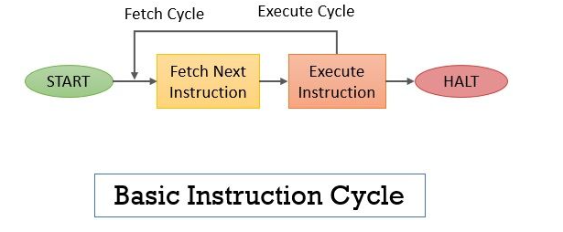

Slide 25
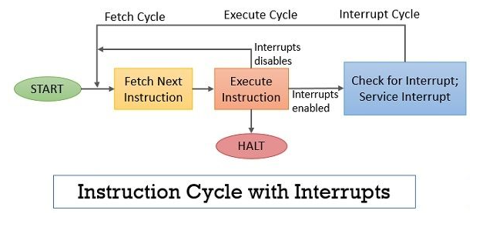

Slide 26
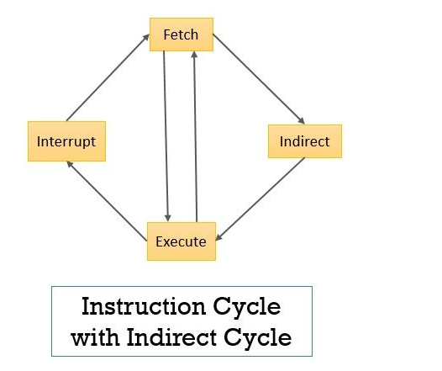

Slide 27
The registers that are required in the processing of the instruction cycle are:
Memory Address Register (MAR): This register holds the address of memory location from where the data has to be fetched or to where the data has to be stored.
Memory Buffer Register (MBR): This register stores the data that is either fetched from the memory or that has to be stored in the memory.
Program Counter (PC): This is also called the instruction address register as it holds the address of the instruction that has to be executed next.
Instruction Register (IR): This register holds the instruction that has to be interpreted.

Slide 28
With instruction cycle, there are 4 other cycles:
FETCH
INDIRECT
EXECUTE
INTERRUPT

Slide 29
INSTRUCTION CYCLE:
These 4 cycles are followed by each other in some fashion.
The Indirect Cycle is always followed by the Execute Cycle. The Interrupt Cycle is always followed by the Fetch Cycle. For both fetch and execute cycles, the next cycle depends on the state of the machine.

Slide 30
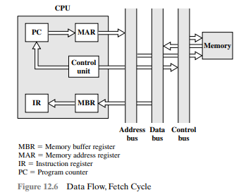
FETCH CYCLE:
Reads the next instruction from memory into the processor.

Slide 31
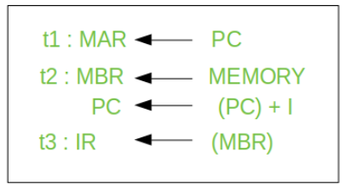
FETCH CYCLE:
A simple Fetch Cycle consist of three steps and four micro-operation. Symbolically, we can write these sequence of events as follows:-

Slide 32
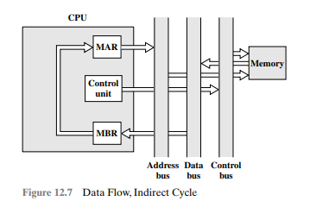
INDIRECT CYCLE:
Once instruction is fetched, next stage is to fetch the source operands and to fetch these indirect addressing is used. If so, an indirect cycle is performed.

Slide 33
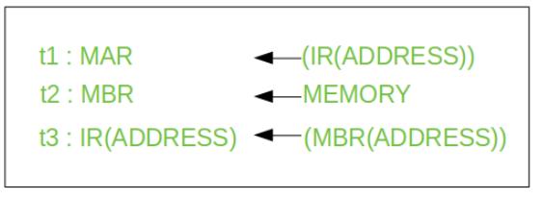
INDIRECT CYCLE:
Following micro-operations takes place:-

Slide 34

EXECUTE CYCLE:
Lets take an hypothetical example :- consider an add instruction:
Here, this instruction adds the content of location X to register R.

Slide 35
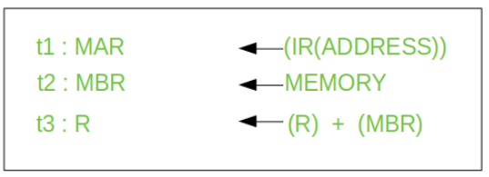
EXECUTE CYCLE:
Corresponding micro-operation will be:-

Slide 36
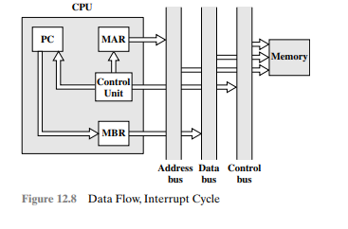
INTERRUPT CYCLE:
If interrupts are enabled and an interrupt has occurred, it saves the current process state and service the interrupt.

Slide 37
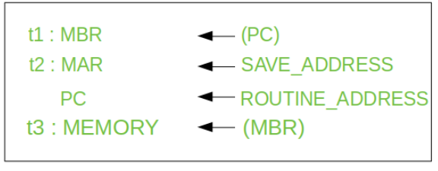
INTERRUPT CYCLE:
Following micro-operations takes place:-

Slide 38
ADVANTAGES:
Standardization: The instruction cycle provides a standard way for CPUs to execute instructions, which allows software developers to write programs that can run on multiple CPU architectures
Efficiency: By breaking down the instruction execution into multiple steps, the CPU can execute instructions more efficiently.
Pipelining: The instruction cycle can be pipelined, which means that multiple instructions can be in different stages of execution at the same time. This improves the overall performance of the CPU, as it can process multiple instructions simultaneously.

Slide 39
DISADVANTAGES:
Complexity: The instruction cycle can be complex to implement, especially if the CPU architecture and instruction set are complex. This complexity can make it difficult to design, implement, and debug the CPU.
Limited parallelism: While pipelining can improve the performance of the CPU, it also has limitations. For example, some instructions may depend on the results of previous instructions, which limits the amount of parallelism that can be achieved. This can reduce the effectiveness of pipelining and limit the overall performance of the CPU.

Slide 40

Have a good dayyyy!!!

